Slide 1

Ch.11. Accessing MySQL Database
from the Web with PHP
Siva R Jasthi
ICS325 – Internet Application Development
Information and Computer Sciences
Metropolitan State University

Slide 2
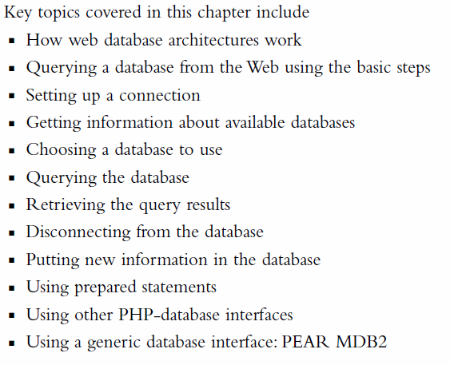
Outline

Slide 3
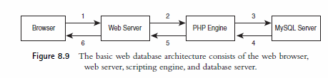
Web Database Architecture
Web Browser issues an HTTP request for a page.
Web Server receives this request, retrieves that page and passes to PHP Engine for processing.
PHP engine parses the script. This script contains the SQL commands / query string to fetch data from MySQL server.
MySQL server receives the database query, processes it, and sends the results – back to PHP Engine.
PHP engine finishes running the script, formats the query results nicely in HTML. It then returns the HTML to the web server.
Web server passes the HTML back to the browser.

Slide 4
(Querying = Accessing) a Database from the web
Check and filter data coming from the user
Setup a connection to appropriate database
Query the database
Retrieve the results
Present the results back to the user
Free up the results and Close the database connection

Slide 5

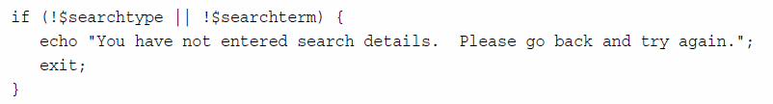
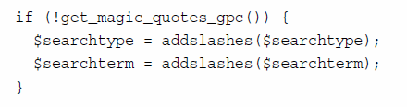
1. Check and Filter the data coming in from the web
Trim the white space
Ensure that there is some input (not just the white space)
Sanitize the input by adding slashes for special characters

Slide 6
magic_quotes_gpc setting in php.ini
; Magic quotes are a preprocessing feature of PHP where PHP will attempt to
; escape any character sequences in GET, POST, COOKIE and ENV data which might
; otherwise corrupt data being placed in resources such as databases before
; making that data available to you. Because of character encoding issues and
; non-standard SQL implementations across many databases, it's not currently
; possible for this feature to be 100% accurate. PHP's default behavior is to
; enable the feature. We strongly recommend you use the escaping mechanisms
; designed specifically for the database your using instead of relying on this
; feature. Also note, this feature has been deprecated as of PHP 5.3.0 and is
; scheduled for removal in PHP 6.
; Default Value: On
; Development Value: Off
; Production Value: Off
; http://php.net/magic-quotes-gpc
magic_quotes_gpc=Off

Slide 7
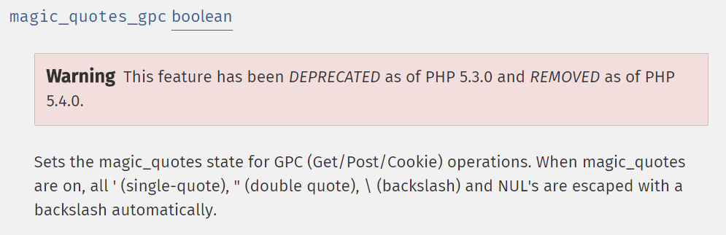
magic_quotes_gpc documentation
NOTE:
magic_quotes_gpc is set to OFF
get_magic_quotes_gpc always returns false
This feature has been deprecated in the latest versions of PHP
So, you have to do escape the special characters explicitly.
Don’t rely on magic_quotes_gpc setting.

Slide 8
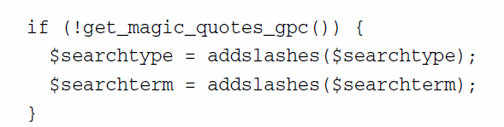
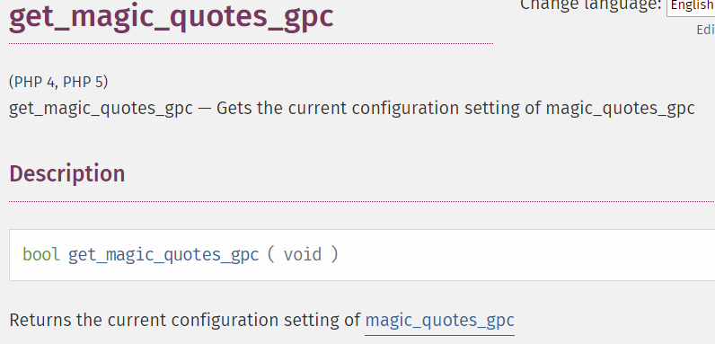
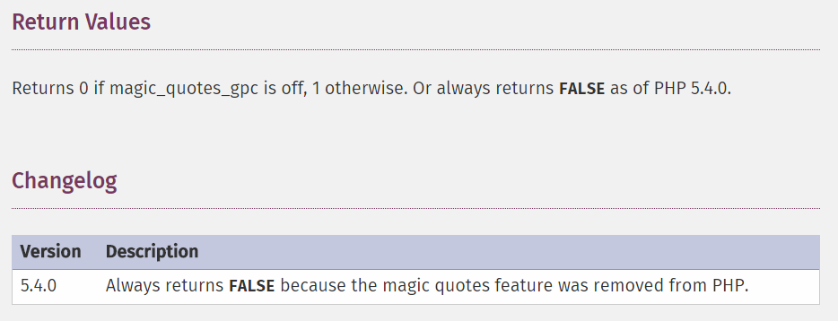
get_magic_quotes_gpc documentation
FALSE
If magic_quotes_gpc is OFF / FALSE ,
then addslashes to escape special characters;
If

Slide 9
2. Setting up a connection
PHP Library for connecting to MySQL is called mysqli (i stands for improved).
There are two ways to access the database through mysql
Through Object-Oriented Syntax
Through Procedural Sytanx

Slide 10
2. Setting up a connection (Contd.)
Database connection: Through Object-Oriented Syntax
Database connection: Through Procedural Sytanx
Both are similar in terms of functionality and performance.
Stick to one convention for consistency

Slide 11
2.1 Choosing a database to use
In MySQL monitor, “use <db_name>” command specifies which database to be used.
In similar lines, mysqli constructor and mysqli_connect function both takes the db_name as a parameter.
Database connection: Through Object-Oriented Syntax
Database connection: Through Procedural Sytanx

Slide 12
3. Querying the database
Using DML, we manipulated the database.
INSERT, UPDATE, DROP, ALTER, CREATE are some of the commands we used to manipulate the tables, rows, columns, values.
Query String is same as “the command + any parameters that command takes”
Query String does not mean we only query the datbase (for retrieving the values)
Query String is any MySQL Command we pass in through PHP.

Slide 13
3. Querying the database (Contd.)
How do you search for the book titles in MySQL?
SELECT * from books where title = “PHP and MySQL”;
SELECT * from books where title LIKE “%PHP%”
How do you search for the authors in MySQL?
SELECT * from books where author = “Luke Welling”;
SELECT * from books where author LIKE “%Luke%”
NOTE: Notice the use of like and equal in the where clause. It is usually a good idea to be more tolerant in a database search. LIKE supports the use of wild cards while = (equals) requires exact match.

Slide 14
3. Querying the database (Contd.)
Consider these two statements. How do you parameterize and set up a Query String for PHP?
SELECT * from books where title LIKE “%PHP%”
SELECT * from books where author LIKE “%Luke%”
Query String in PHP
$query_string = “SELECT * from books
WHERE “.$searchtype.”
LIKE ‘%.$searchterm.”%’”;
NOTE: Remember that the query you send to MySQL does not need a semicolon at the end of it, unlike a query you type into the MySQL monitor.

Slide 15
3.1 Running the query
Query String in PHP
$query_string = “SELECT * from books
WHERE “.$searchtype.”
LIKE ‘%.$searchterm.”%’”;
Once you set up the Query String, you run this query.
// $result is a result object in OO
$result = $db-> query ($query_string);
// $result is a resource in Procedural Syntax
$result = mysql_connect ($db, $query_string)

Slide 16
4. Retrieving the Query Results
5. Displaying the Query Results
// $result is a result object in OO
$result = $db-> query ($query_string);
// $result is a resource in Procedural Syntax
$result = mysql_connect ($db, $query_string)
Numerous mysqli functions are available to manipulate the $result
Reference: http://www.w3schools.com/php/php_ref_mysqli.asp

Slide 17
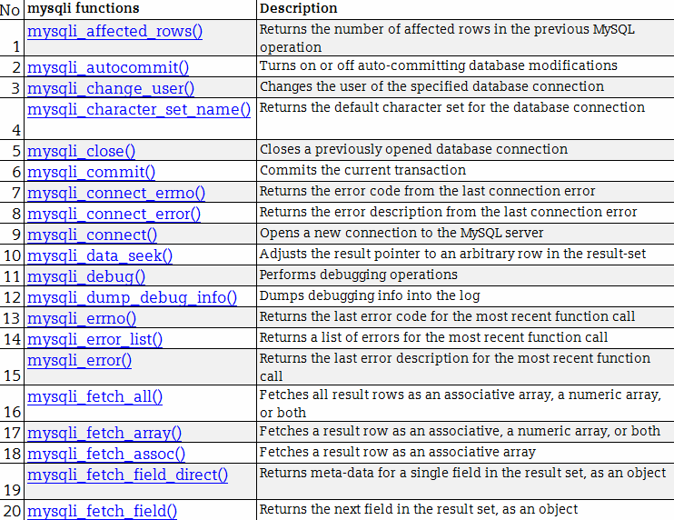
mysqli reference

Slide 18
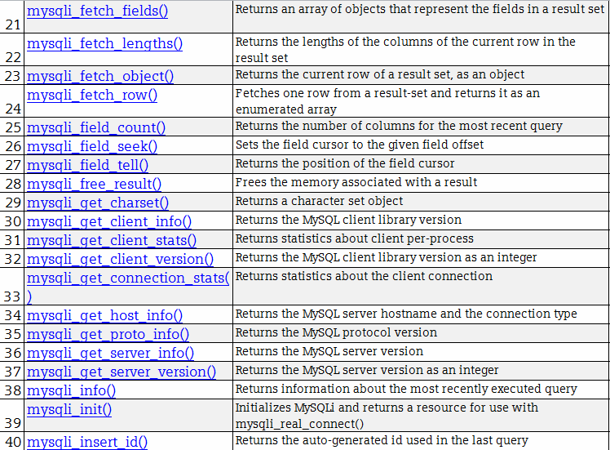
mysqli reference

Slide 19
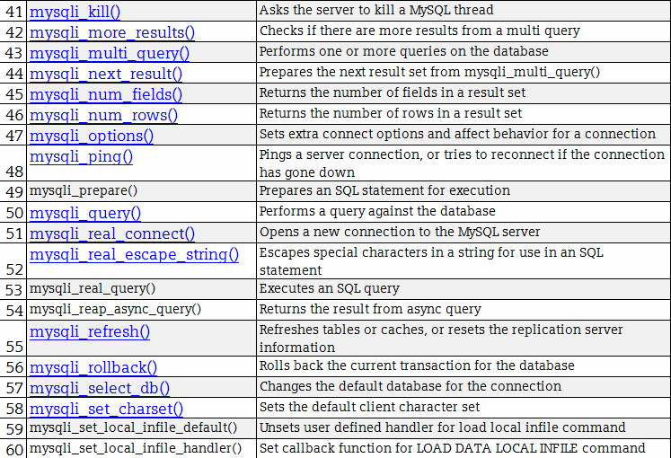
mysqli reference

Slide 20
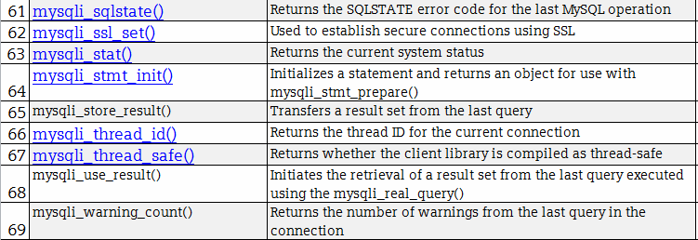
mysqli reference

Slide 21
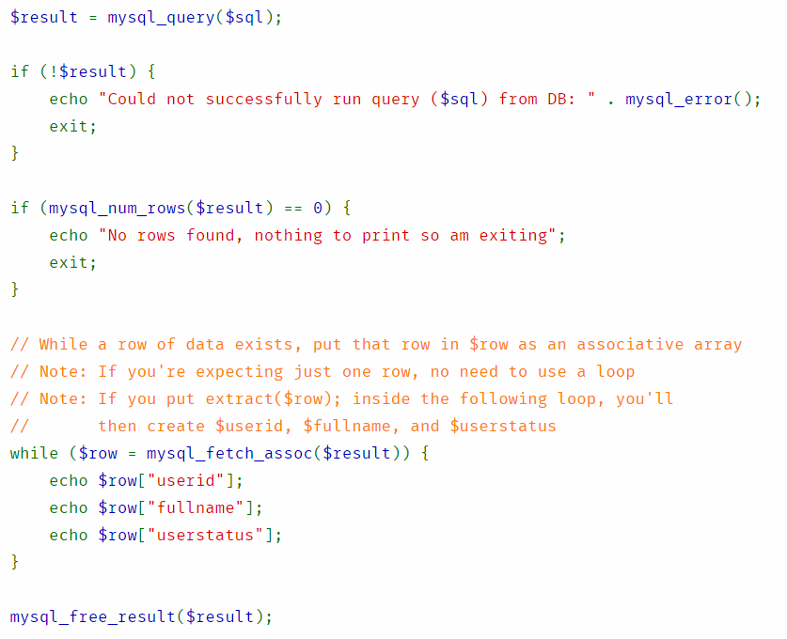
$result and mysqli example
mysqli_fetch_assoc
It is good idea to say
stripslashes($row[“fullname”]);

Slide 22
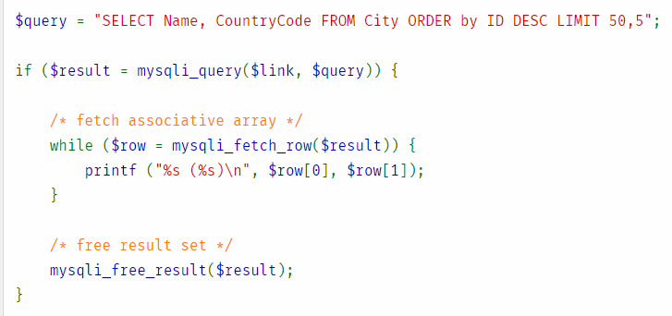
$result and mysqli example
mysqli_fetch_rows

Slide 23
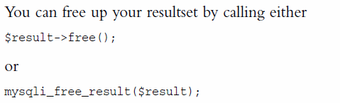
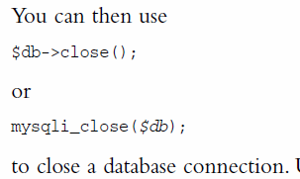
6. Disconnect from the database

Slide 24
PHP- MySQL cycle
Check and filter data coming from the user
Setup a connection to appropriate database
Query the database
Retrieve the results
Present the results back to the user
Free up the results and Close the database connection
While doing the above, things can go wrong in many ways
Database doesn’t exist
User doesn’t exist
Database connection failed
Privileges doesn’t exist
Result set is empty
There is no data in a row or column
Results are not freed, thus slowing down the system.

Slide 25
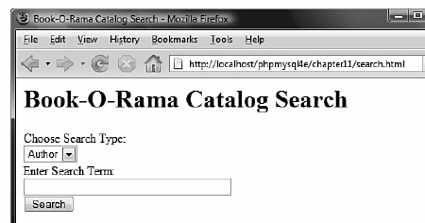
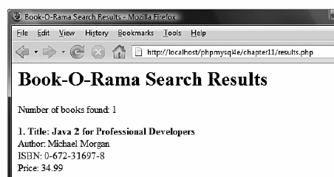
Revisiting the query example

Slide 26
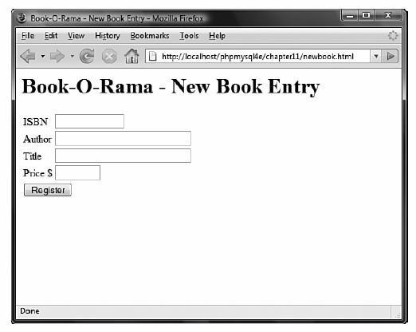
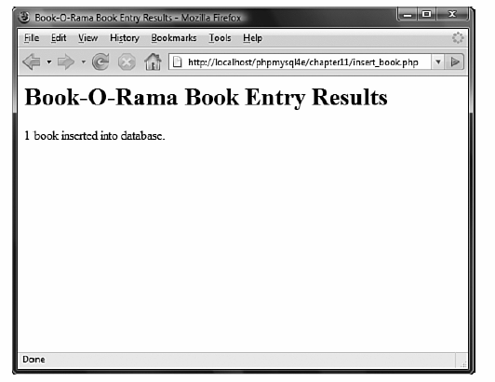

Putting new information in the database
(Same pattern, different query string
Let us review Chapter 11
newbook.html
insert_book.php

Slide 27
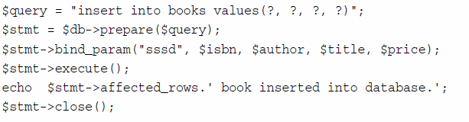
Using Prepared Statements
Prepared statements helps in speeding up the execution.
Useful when the same query is executed many times (for example, number of inserts)
Prepared Statements are templates with no data.
Then you send the data separately and bind the data.
You create the template once, but send the data many times.
Is indicating the data types of values sent;
s = string; d = double; i = integer; b = blob

Slide 28
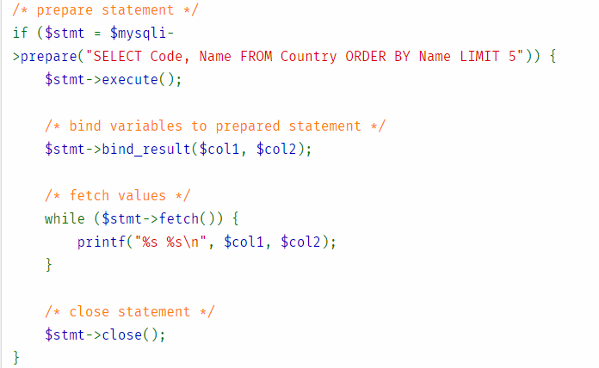
Binding the Results through prepared statements - Example

Slide 29
Database Connections - Abstractions
We just discussed mysqli (the database connection library to MySQL database).
PHP supports connections to many databases (such as Oracle, SQLServer, PostgresSQL)
If there is no specific PHP library available for the database server, then generic ODBC functions (Open Data Base Connectivity) can be used.
To ensure that your PHP code doesn’t change, whenever you switch the vendors, you can also make use of PEAR MDB2 (which is a database abstraction layer)

Slide 30
References
SQL Tutorial at W3 Schools
http://www.w3schools.com/sql/
PHP Manual on mysqli
http://php.net/manual/en/book.mysqli.php

